Slide 1
Chapter 4
The Divide-and-Conquer Strategy

Slide 2
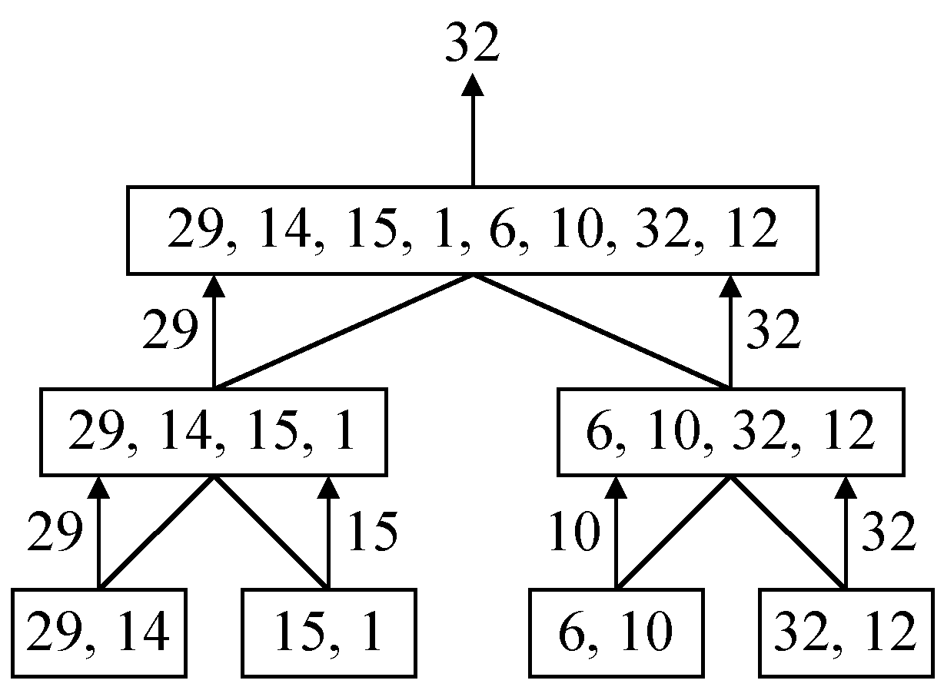
A Simple Example
Finding the maximum of a set S of n numbers

Slide 3

Time Complexity
Time complexity:
Calculation of T(n):
Assume n = 2^{k},
T(n) = 2T(n/2)+1
= 2(2T(n/4)+1)+1
= 4T(n/4)+2+1
:
=2^{k-1}T(2)+2^{k-2}+…+4+2+1
=2^{k-1}+2^{k-2}+…+4+2+1
=2^{k}-1 = n-1

Slide 4
A General Divide-and-Conquer Algorithm
Step 1: If the problem size is small, solve this problem directly; otherwise, split the original problem into 2 sub-problems with equal sizes.
Step 2: Recursively solve these 2 sub-problems by applying this algorithm.
Step 3: Merge the solutions of the 2 sub- problems into a solution of the original problem.

Slide 5
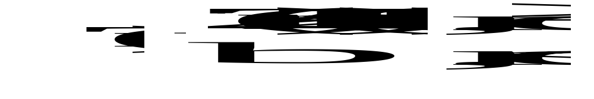
Time Complexity of the General Algorithm
Time complexity:
where S(n) : time for splitting
M(n) : time for merging
b : a constant
c : a constant

Slide 6
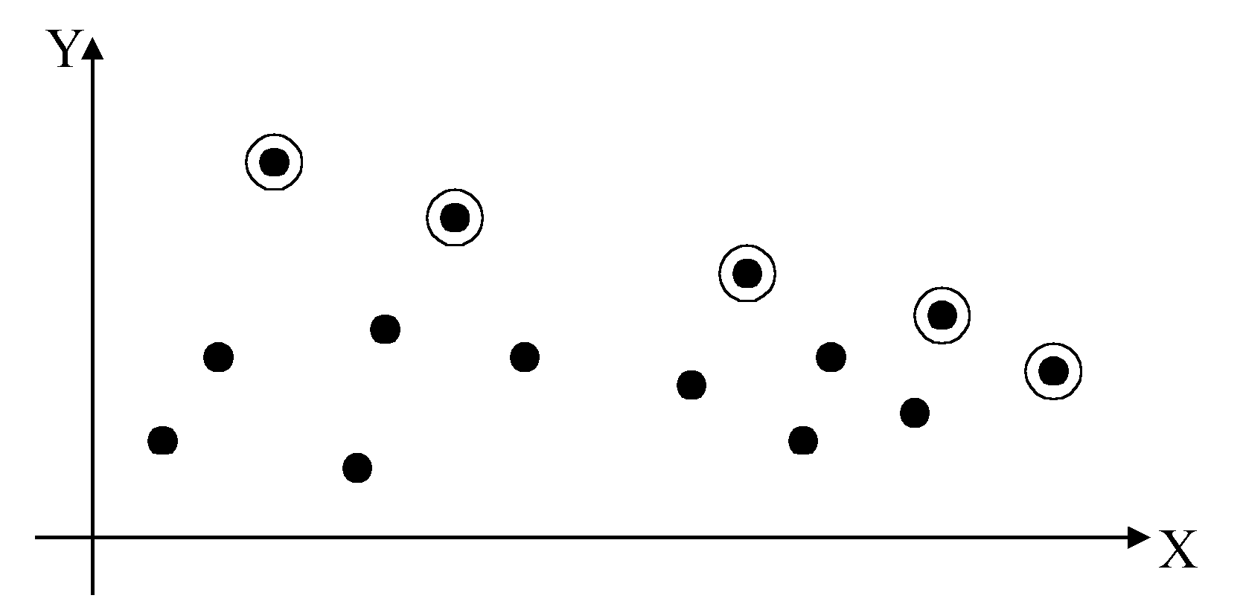
2-D Maxima Finding Problem
Def : A point (x₁, y₁) dominates (x₂, y₂) if x₁ > x₂ and y₁ > y₂. A point is called a maxima if no other point dominates it.
Straightforward method : Compare every pair of points.
Time complexity:
O(n²)

Slide 7
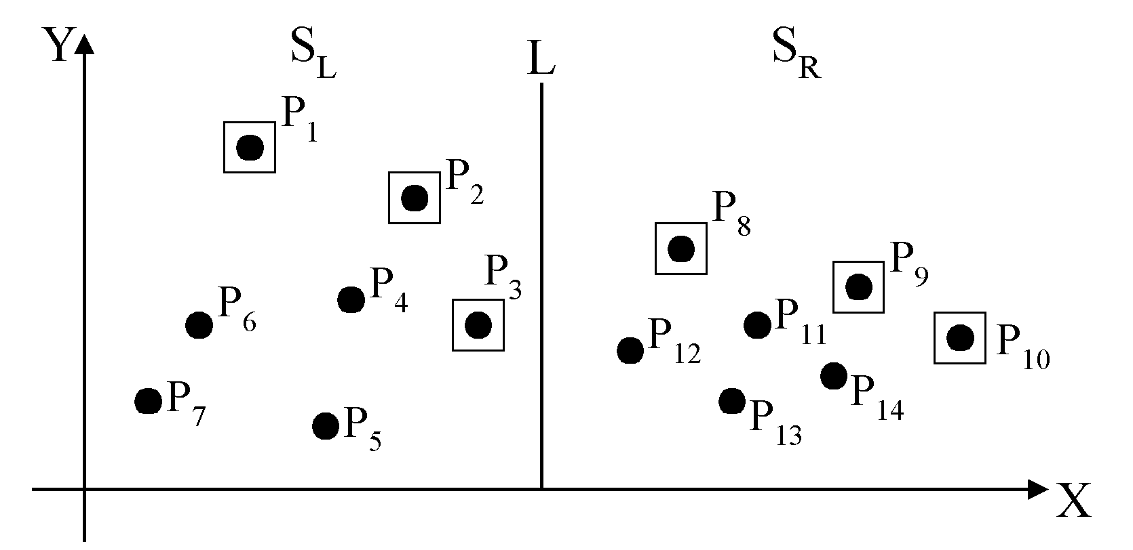
Divide-and-Conquer for Maxima Finding
The maximal points of S_{L} and S_{R}

Slide 8
The algorithm:
Input: A set S of n planar points.
Output: The maximal points of S.
Step 1: If S contains only one point, return it as the maxima. Otherwise, find a line L perpendicular to the X-axis which separates S into S_{L}and S_{R}, with equal sizes.
Step 2: Recursively find the maximal points of S_{L} and S_{R} .
Step 3: Find the largest y-value of S_{R}, denoted as y_{R}. Discard each of the maximal points of S_{L} if its y-value is less than y_{R}.

Slide 9
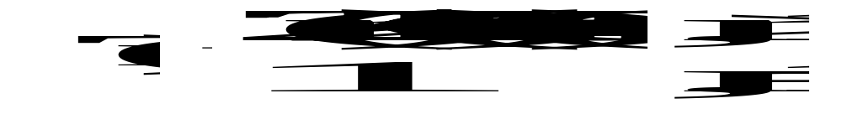
Time complexity: T(n)
Step 1: O(n)
Step 2: 2T(n/2)
Step 3: O(n)
Assume n = 2^{k}
T(n) = O(n log n)

Slide 10
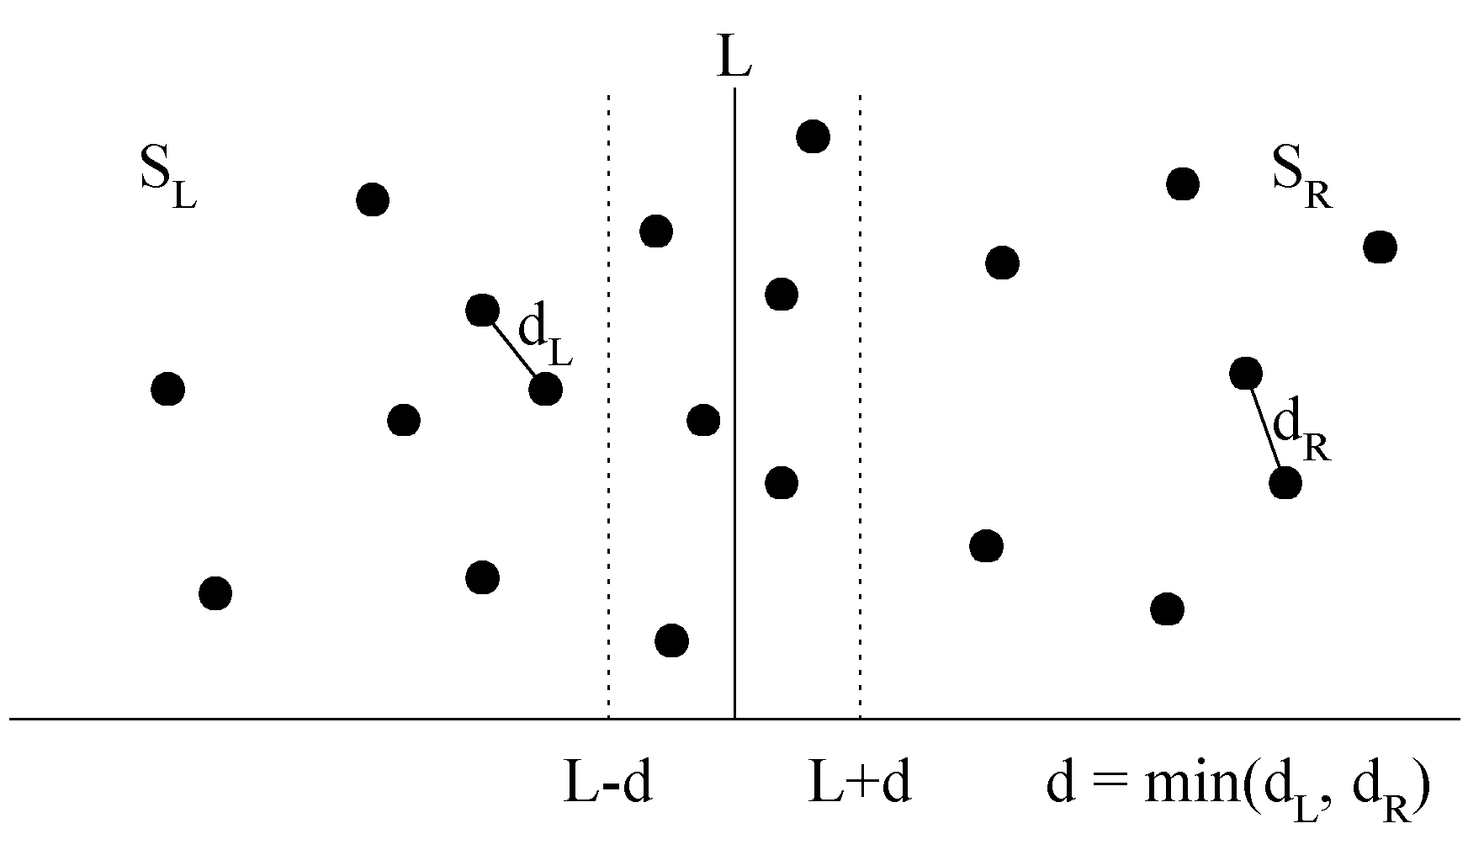
The Closest Pair Problem
Given a set S of n points, find a pair of points which are closest together.
1-D version :
Solved by sorting
Time complexity :
O(n log n)
 2-D version

Slide 11
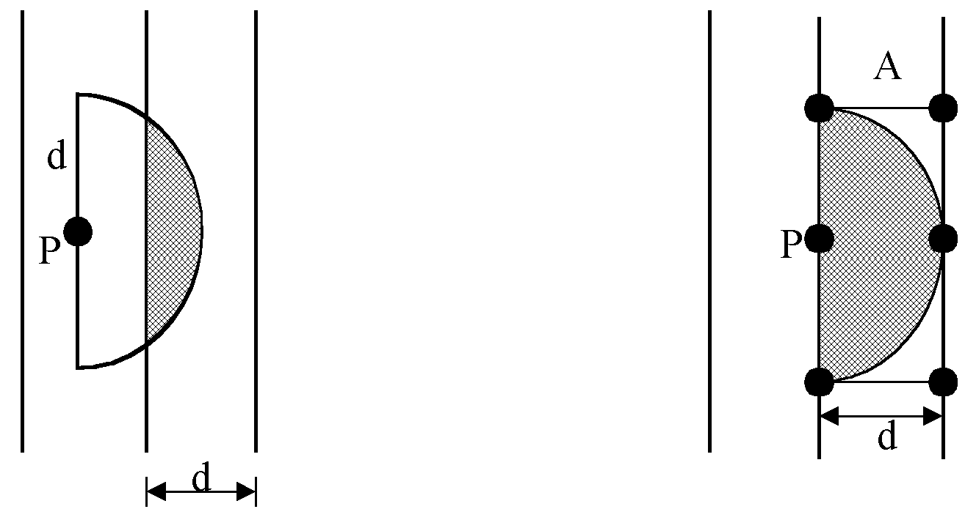
At most 6 points in area A:

Slide 12
The algorithm:
Input: A set S of n planar points.
Output: The distance between two closest points.
Step 1: Sort points in S according to their y-values.
Step 2: If S contains only one point, return infinity as its distance.
Step 3: Find a median line L perpendicular to the X-axis to divide S into S_{L} and S_{R}, with equal sizes.
Step 4: Recursively apply Steps 2 and 3 to solve the closest pair problems of S_{L} and S_{R}. Let d_{L}(d_{R}) denote the distance between the closest pair in S_{L} (S_{R}). Let d = min(d_{L}, d_{R}).

Slide 13
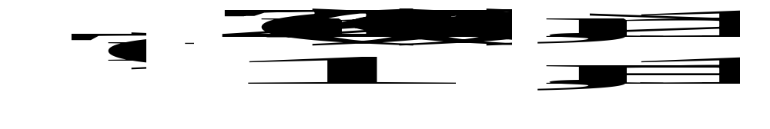
Step 5: For a point P in the half-slab bounded by L-d and L, let its y-value be denoted as y_{P} . For each such P, find all points in the half-slab bounded by L and L+d whose y-value fall within y_{P}+d and y_{P}-d. If the distance d′ between P and a point in the other half-slab is less than d, let d=d′. The final value of d is the answer.
Time complexity: O(n log n)
Step 1: O(n log n)
Steps 2~5:
⇒T(n) = O(n log n)

Slide 14
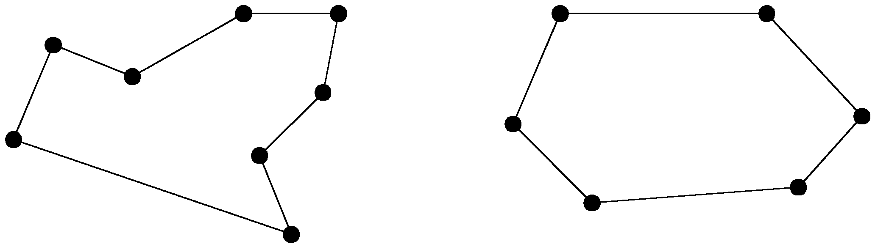
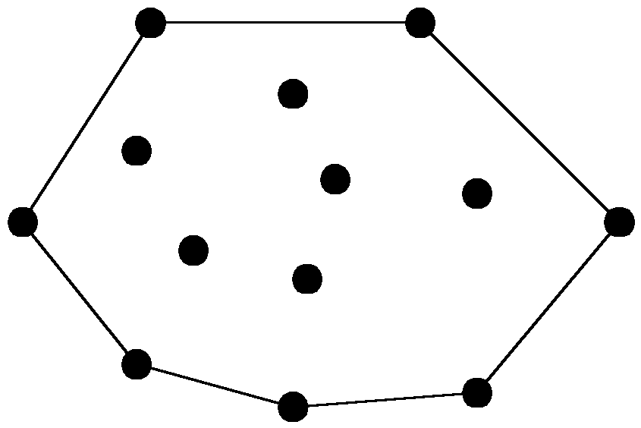
The Convex Hull Problem
Concave polygon:
Convex polygon:
The convex hull of a set of planar points is the smallest convex polygon containing all of the points.

Slide 15
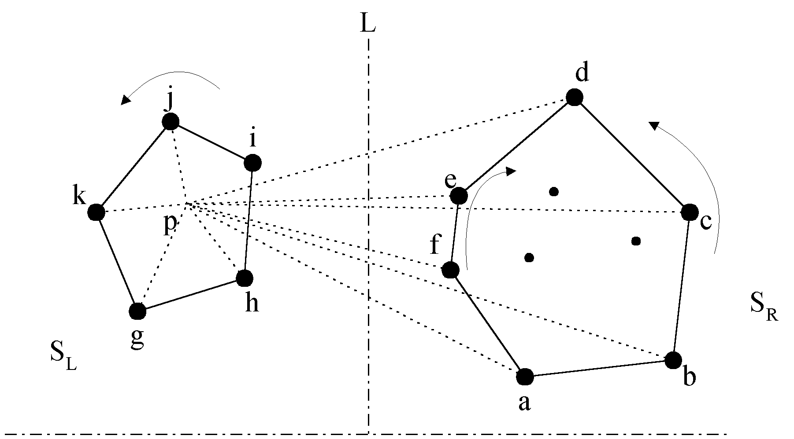
The divide-and-conquer strategy to solve the problem:

Slide 16
The merging procedure:
Select an interior point p.
There are 3 sequences of points which have increasing polar angles with respect to p.
(1) g, h, i, j, k
(2) a, b, c, d
(3) f, e
Merge these 3 sequences into 1 sequence:
g, h, a, b, f, c, e, d, i, j, k.
Apply Graham scan to examine the points one by one and eliminate the points which cause reflexive angles.
(See the example on the next page.)

Slide 17
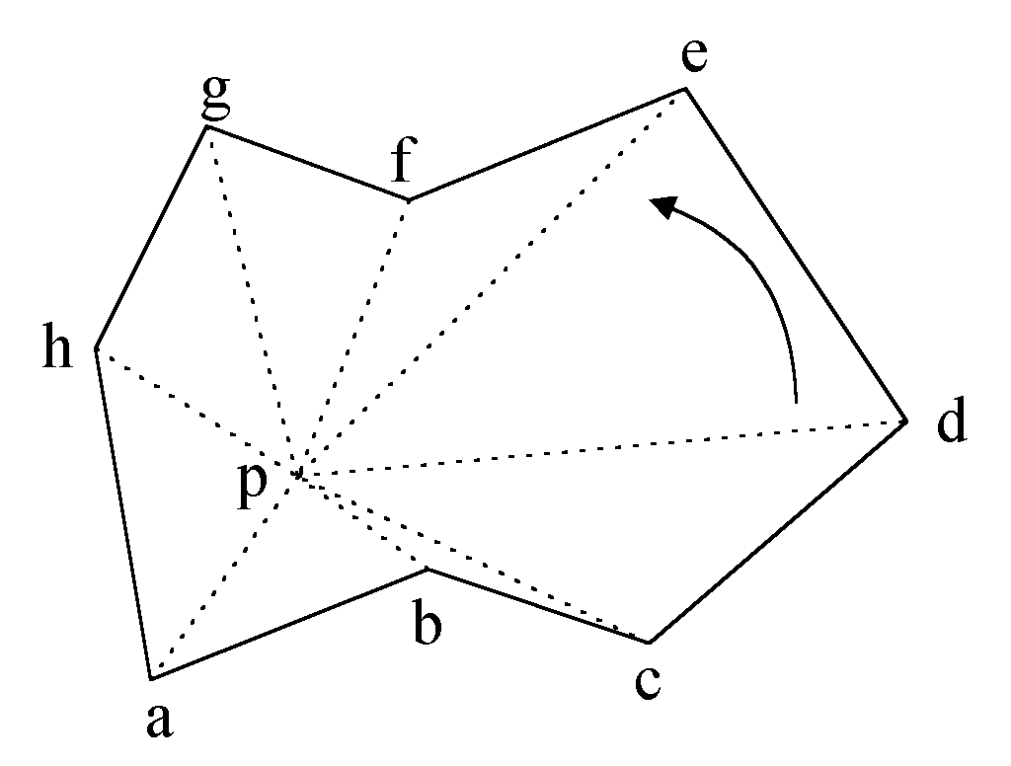
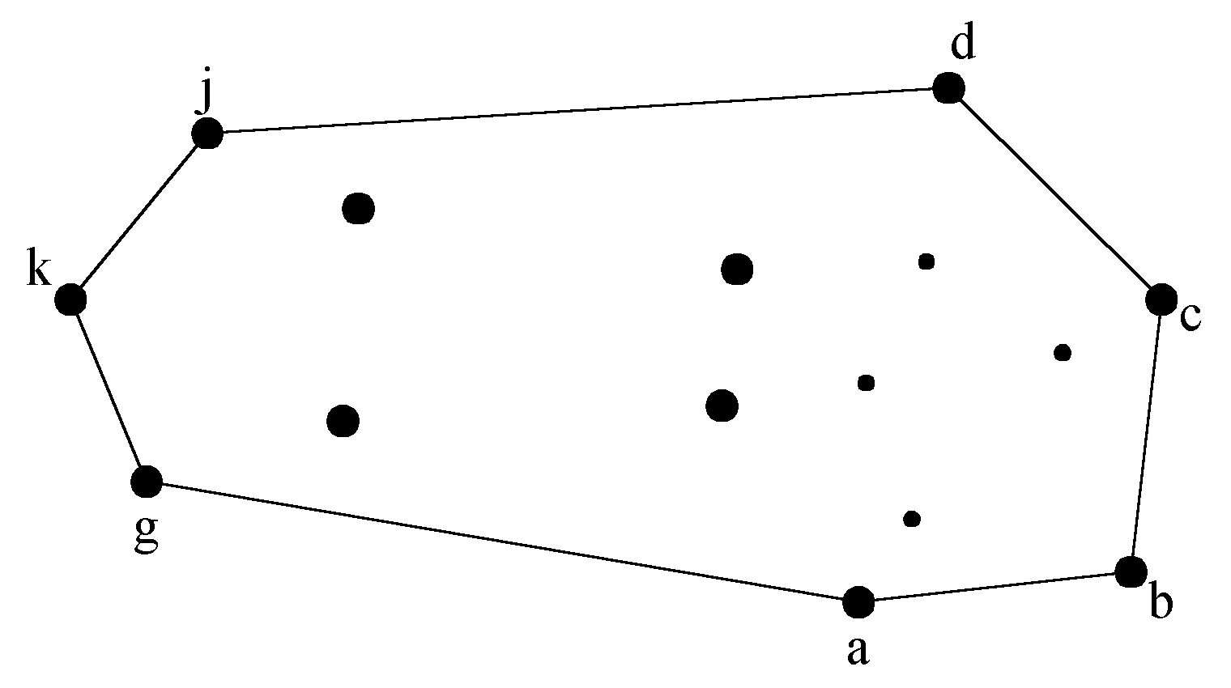
e.g. points b and f need to be deleted.
Final result:

Slide 18
Divide-and-Conquer for Convex Hull
Input : A set S of planar points
Output : A convex hull for S
Step 1: If S contains no more than five points, use exhaustive searching to find the convex hull and return.
Step 2: Find a median line perpendicular to the X-axis which divides S into S_{L} and S_{R}, with equal sizes.
Step 3: Recursively construct convex hulls for S_{L} and S_{R}, denoted as Hull(S_{L}) and Hull(S_{R}), respectively.

Slide 19
Step 4: Apply the merging procedure to merge Hull(S_{L}) and Hull(S_{R}) together to form a convex hull.
Time complexity:
T(n) = 2T(n/2) + O(n)
= O(n log n)

Slide 20
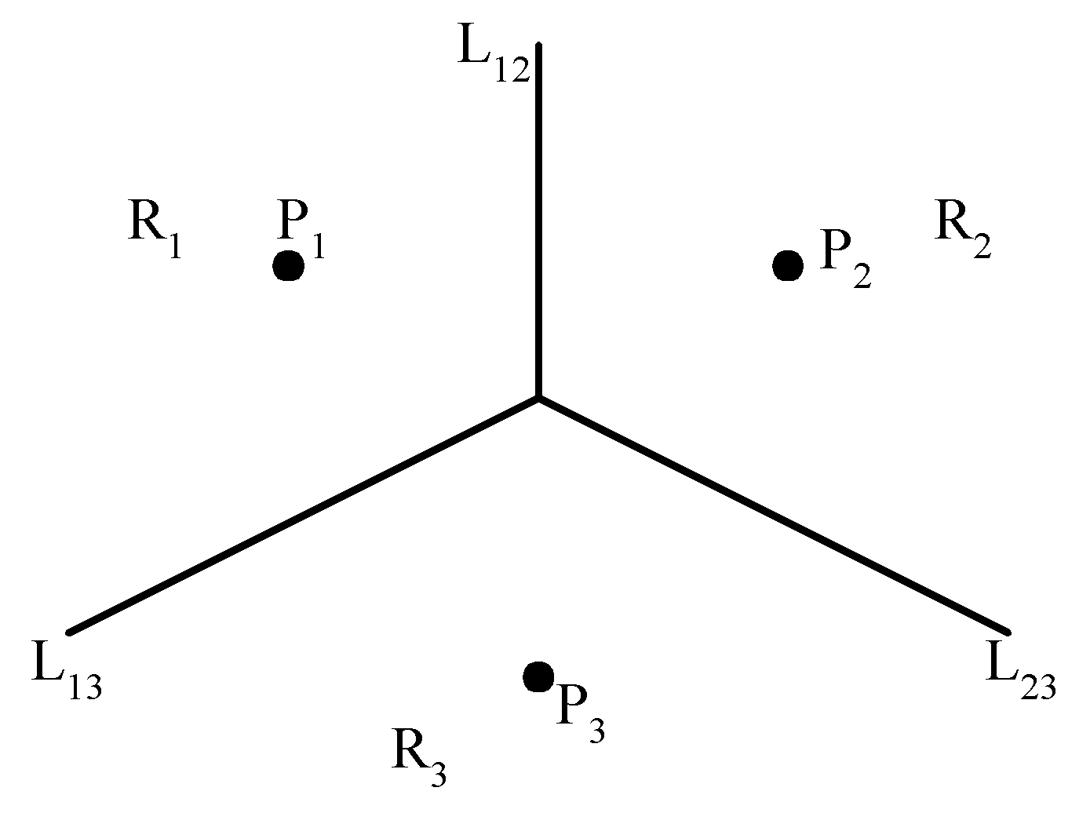
The Voronoi Diagram Problem
e.g. The Voronoi diagram for three points
Each L_{ij} is the perpendicular bisector of the line.

Slide 21
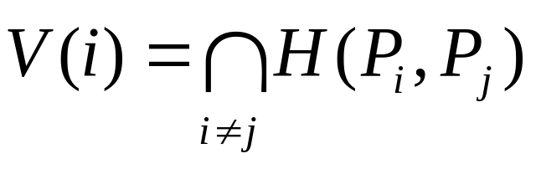
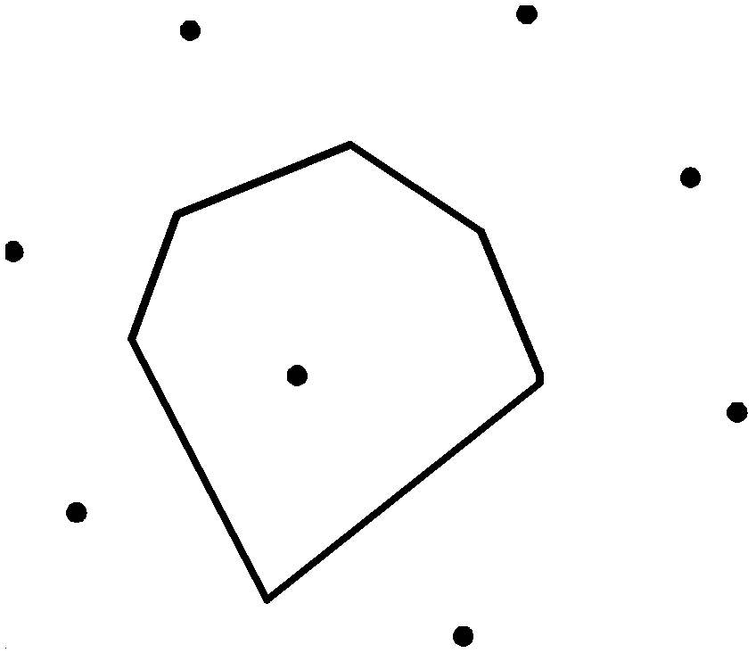
Definition of Voronoi Diagrams
Def : Given two points P_{i}, P_{j} ∈ S, let H(P_{i},P_{j}) denote the half plane containing P_{i}. The Voronoi polygon associated with P_{i} is defined as

Slide 22
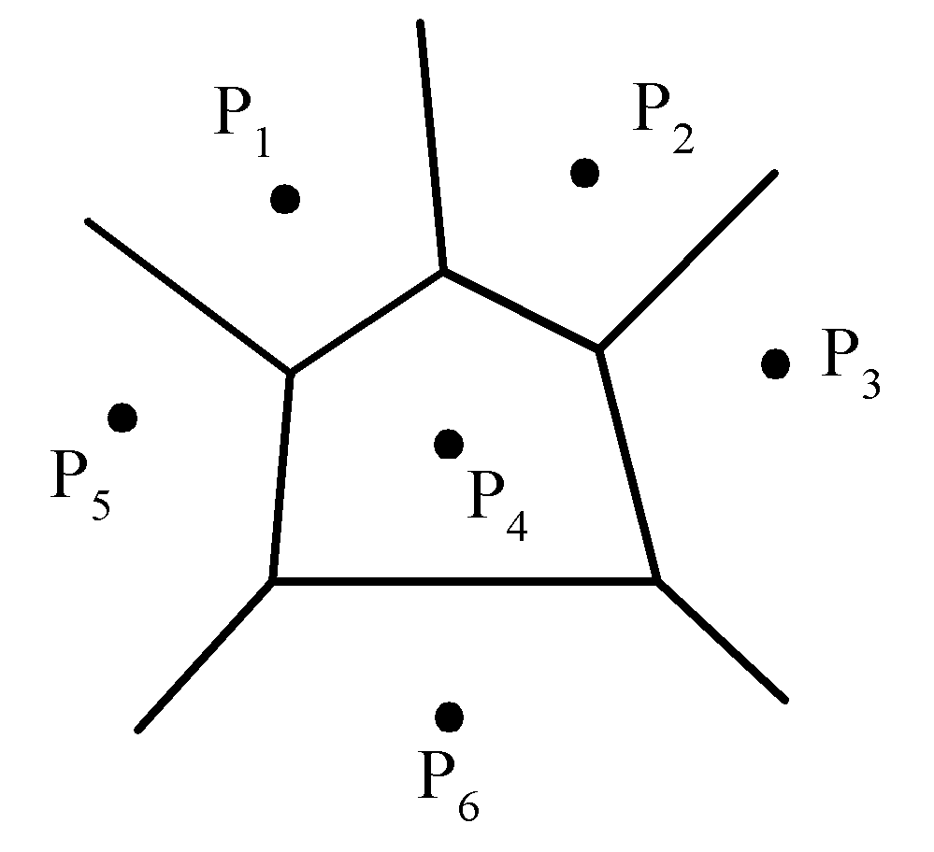
Given a set of n points, the Voronoi diagram consists of all the Voronoi polygons of these points.
The vertices of the Voronoi diagram are called Voronoi points and its segments are called Voronoi edges.

Slide 23
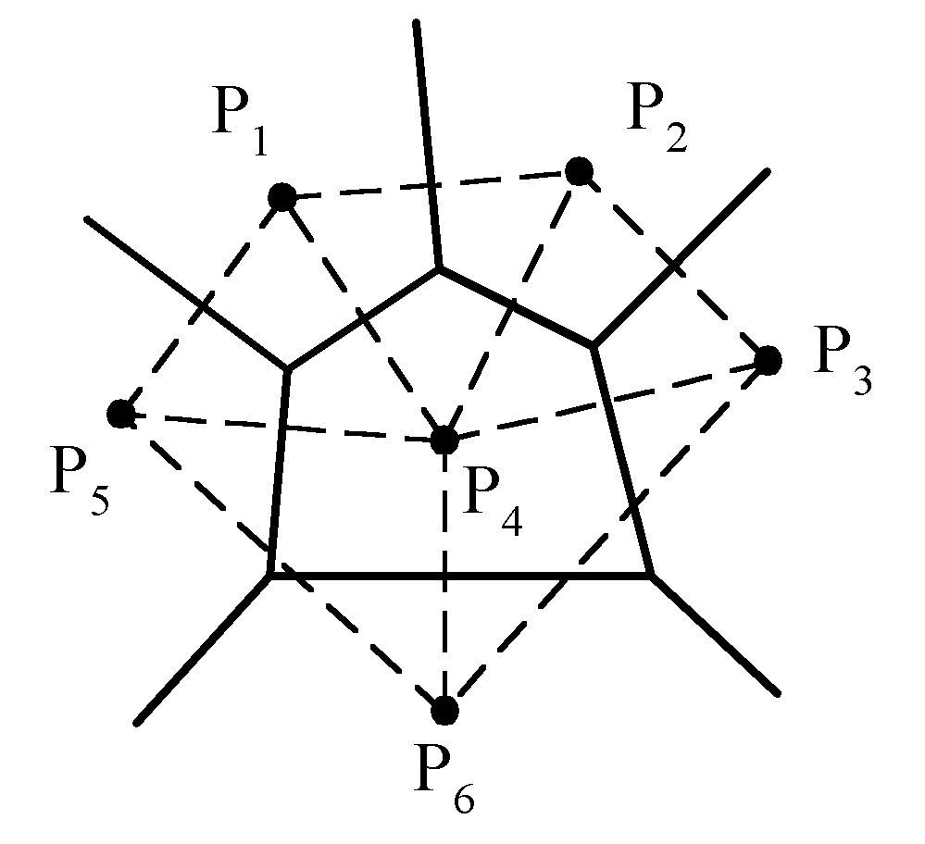
Delaunay Triangulation

Slide 24
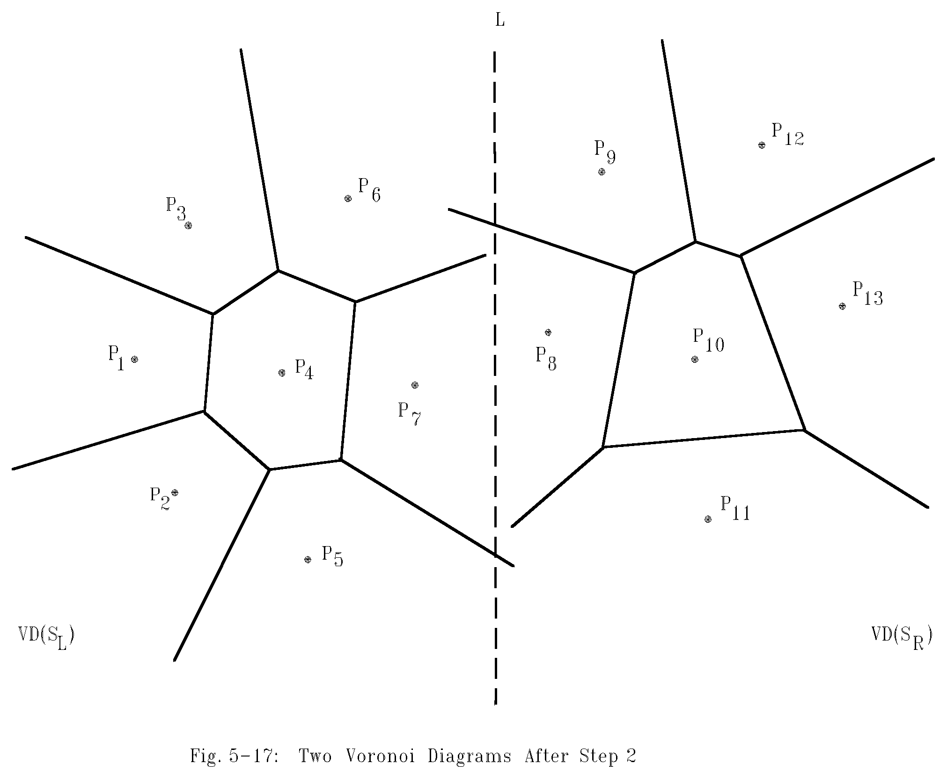
Example for Constructing Voronoi Diagrams
Divide the points into two parts.

Slide 25
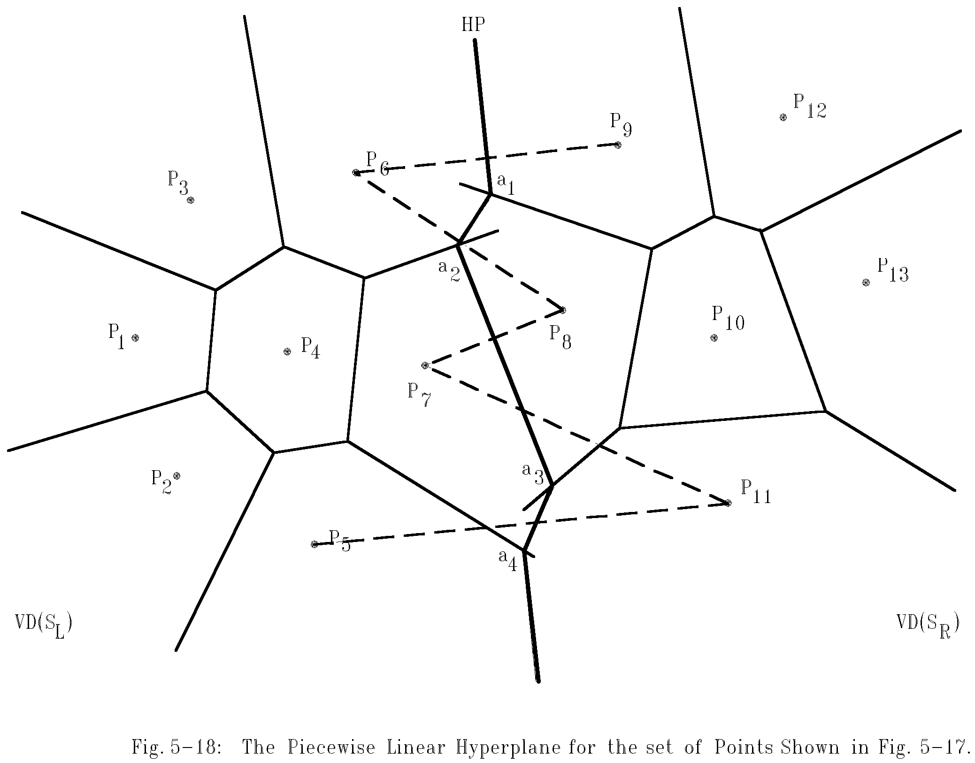
Merging Two Voronoi Diagrams
Merging along the piecewise linear hyperplane

Slide 26
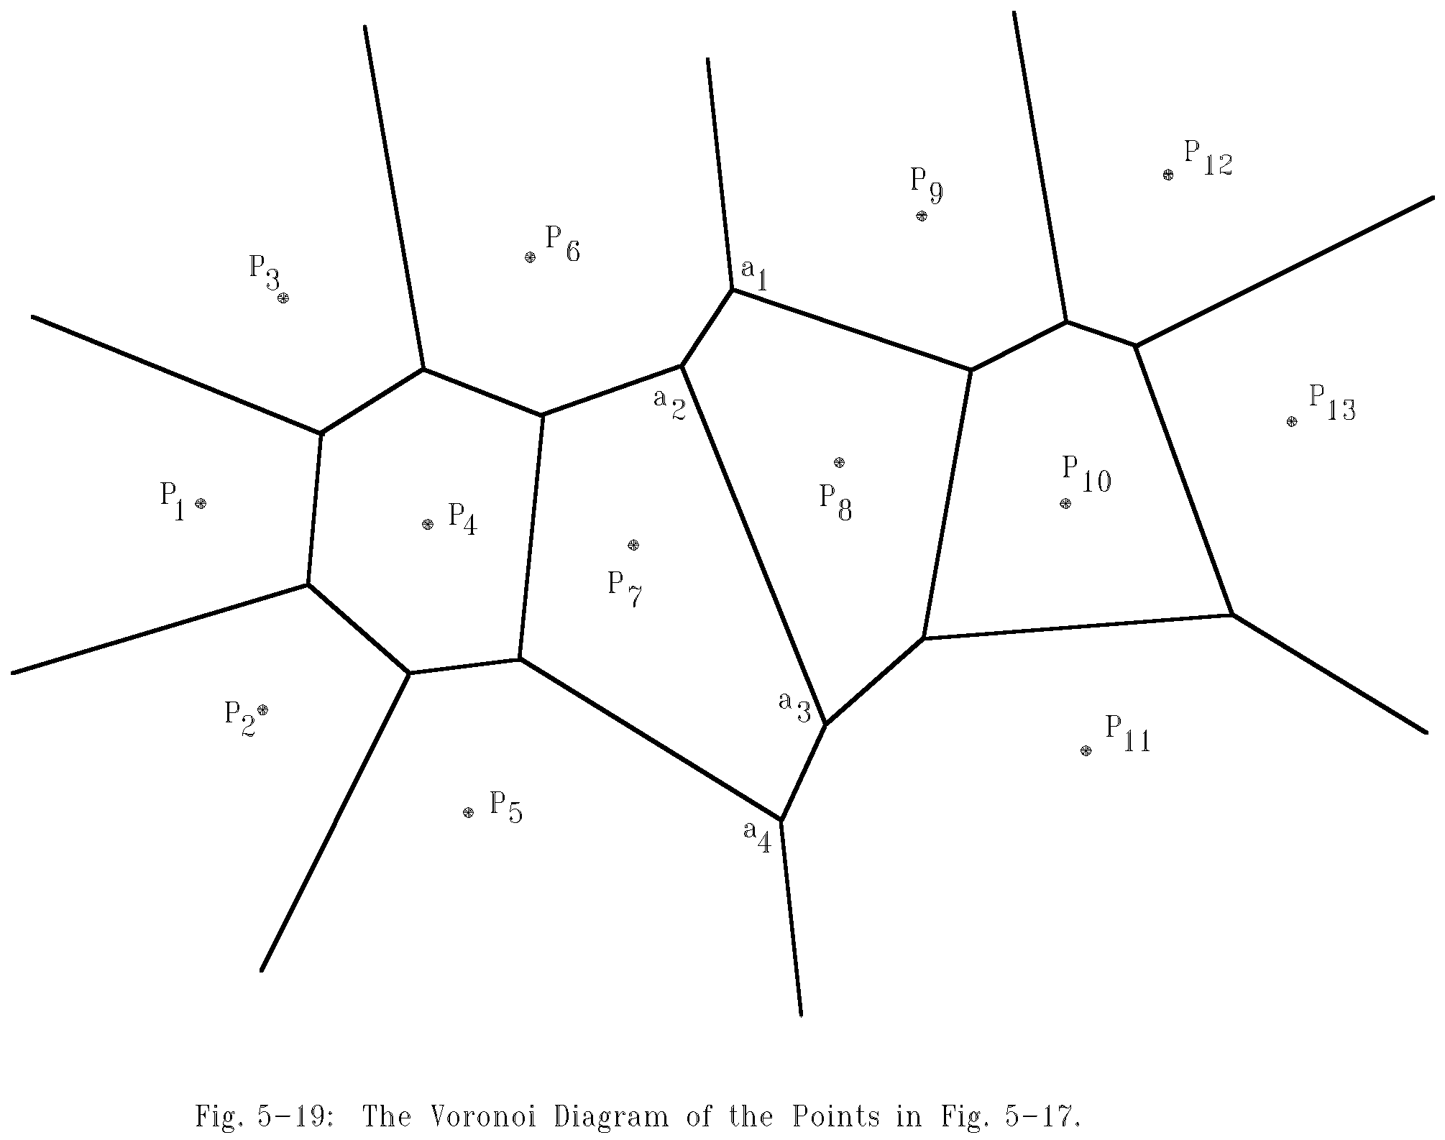
The Final Voronoi Diagram
After merging

Slide 27
Divide-and-Conquer for Voronoi Diagram
Input: A set S of n planar points.
Output: The Voronoi diagram of S.
Step 1: If S contains only one point, return.
Step 2: Find a median line L perpendicular to the X-axis which divides S into S_{L} and S_{R}, with equal sizes.

Slide 28
Step 3: Construct Voronoi diagrams of S_{L} and S_{R} recursively. Denote these Voronoi diagrams by VD(S_{L}) and VD(S_{R}).
Step 4: Construct a dividing piece-wise linear hyperplane HP which is the locus of points simultaneously closest to a point in S_{L} and a point in S_{R}. Discard all segments of VD(S_{L}) which lie to the right of HP and all segments of VD(S_{R}) that lie to the left of HP. The resulting graph is the Voronoi diagram of S.
(See details on the next page.)

Slide 29
Merging Two Voronoi Diagrams into One Voronoi Diagram
Input: (a) S_{L} and S_{R} where S_{L} and S_{R} are divided by a perpendicular line L.
(b) VD(S_{L} ) and VD(S_{R} ).
Output: VD(S) where S = S_{L} ∩S_{R}
Step 1: Find the convex hulls of S_{L} and S_{R}, denoted as Hull(S_{L}) and Hull(S_{R}), respectively. (A special algorithm for finding a convex hull in this case will by given later.)

Slide 30
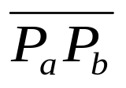
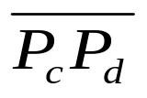
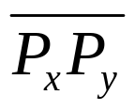
Step 2: Find segments and which join HULL(S_{L} ) and HULL(S_{R} ) into a convex hull (P_{a} and P_{c} belong to S_{L} and P_{b} and P_{d} belong to S_{R}) Assume that lies above . Let x = a, y = b, SG= and HP = ∅ .
Step 3: Find the perpendicular bisector of SG. Denote it by BS. Let HP = HP∪{BS}. If SG = , go to Step 5; otherwise, go to Step 4.

Slide 31
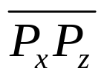

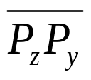
Step 4: The ray from VD(S_{L} ) and VD(S_{R}) which BS first intersects with must be a perpendicular bisector of either or for some z. If this ray is the perpendicular bisector of , then let SG = ; otherwise, let SG = . Go to Step 3.
Step 5: Discard the edges of VD(S_{L}) which extend to the right of HP and discard the edges of VD(S_{R}) which extend to the left of HP. The resulting graph is the Voronoi diagram of S = S_{L}∪S_{R}.

Slide 32
Properties of Voronoi Diagrams
Def : Given a point P and a set S of points, the distance between P and S is the distance between P and P_{i} which is the nearest neighbor of P in S.
The HP obtained from the above algorithm is the locus of points which keep equal distances to S_{L} and S_{R}.
The HP is monotonic in y.

Slide 33

# of Voronoi Edges
# of edges of a Voronoi diagram ≤ 3n - 6, where n is # of points.
Reasoning:
  # of edges of a planar graph with n vertices ≤ 3n - 6.
  A Delaunay triangulation is a planar graph.
  Edges in Delaunay triangulation
  edges in Voronoi diagram.

Slide 34
# of Voronoi Vertices
# of Voronoi vertices ≤ 2n - 4.
Reasoning:
  Let F, E and V denote # of face, edges and vertices in a planar graph.
  Euler’s relation: F = E - V + 2.
  In a Delaunay triangulation,
  V = n, E ≤ 3n – 6
  ⇒ F = E - V + 2 ≤ 3n - 6 - n + 2 = 2n - 4.

Slide 35
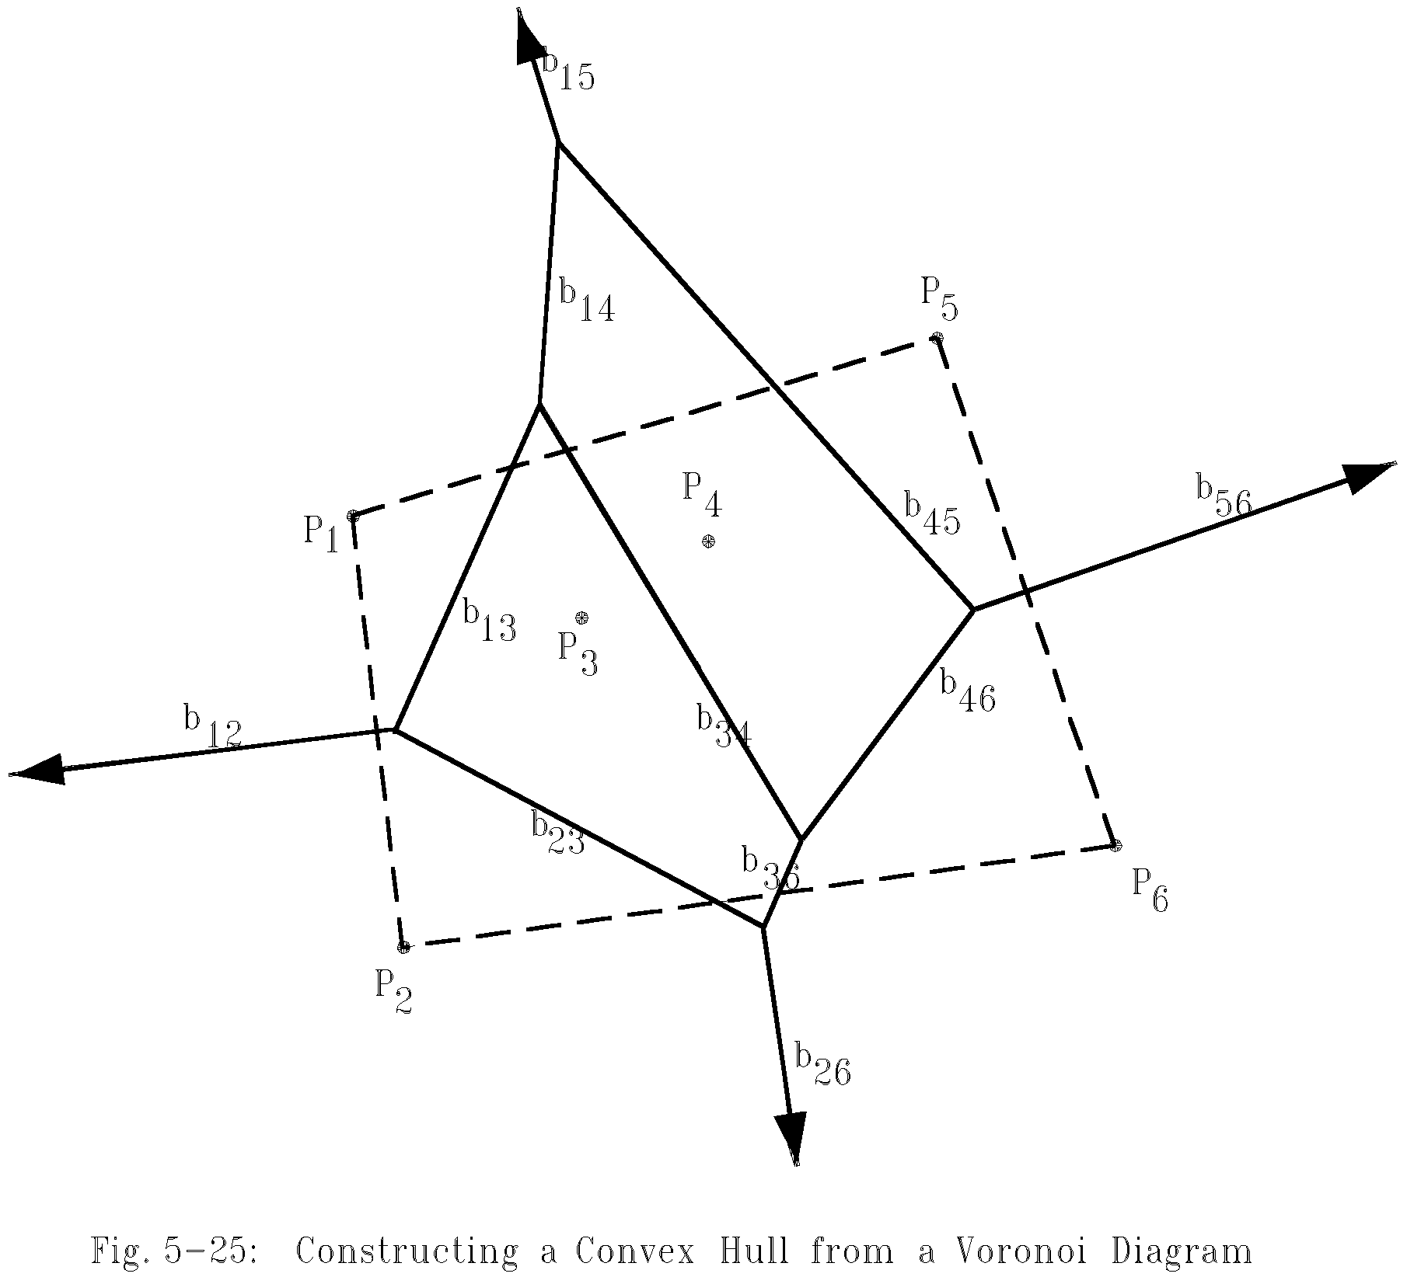
Construct a Convex Hull from a Voronoi Diagram
After a Voronoi diagram is constructed, a convex hull can by found in O(n) time.

Slide 36
Construct a Convex Hull from a Voronoi Diagram
Step 1: Find an infinite ray by examining all Voronoi edges.
Step 2: Let P_{i} be the point to the left of the infinite ray. P_{i} is a convex hull vertex. Examine the Voronoi polygon of P_{i} to find the next infinite ray.
Step 3: Repeat Step 2 until we return to the starting ray.

Slide 37
Time Complexity
Time complexity for merging 2 Voronoi diagrams:
Total: O(n)
  Step 1: O(n)
  Step 2: O(n)
  Step 3 ~ Step 5: O(n)
  (at most 3n - 6 edges in VD(S_{L}) and VD(S_{R}) and at most n segments in HP)
Time complexity for constructing a Voronoi diagram: O(n log n) because T(n) = 2T(n/2) + O(n) = O(n log n)

Slide 38
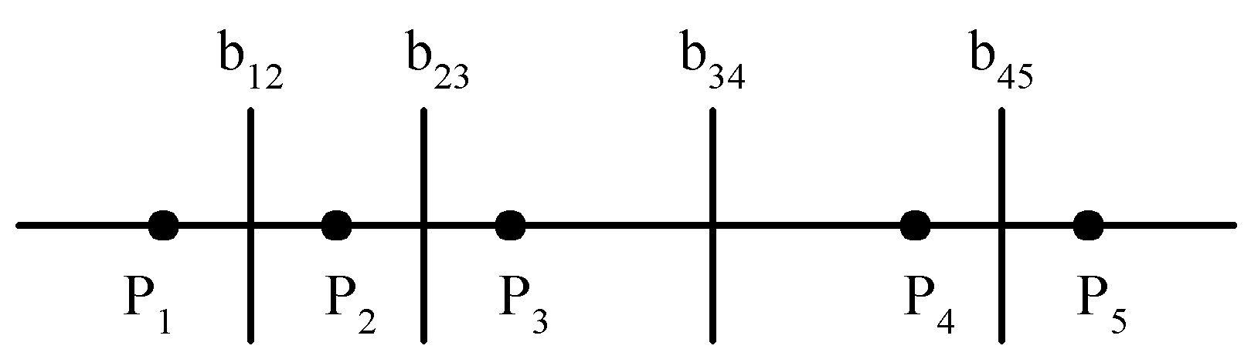
The Lower Bound of the Voronoi Diagram Problem
The lower bound of the Voronoi diagram problem is Ω(n log n).
sorting ∝ Voronoi diagram problem
The Voronoi diagram for a set of points on a straight line

Slide 39
Applications of Voronoi Diagrams
The Euclidean nearest neighbor searching problem.
The Euclidean all nearest neighbor problem.

Slide 40
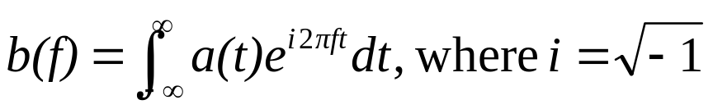
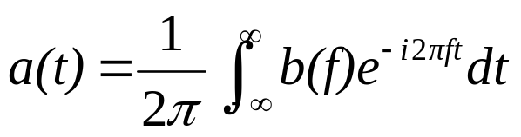
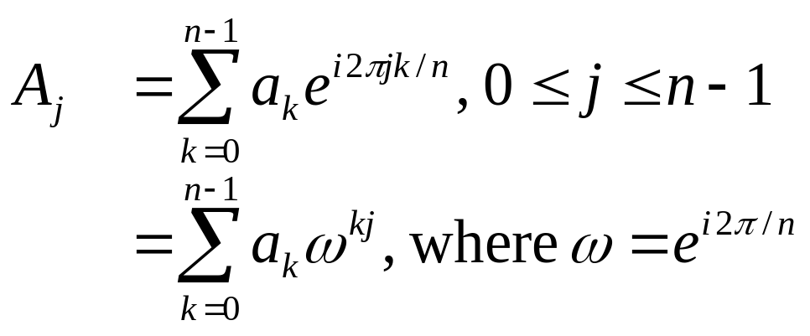
Fast Fourier Transform (FFT)
Fourier transform
Inverse Fourier transform
Discrete Fourier transform(DFT)
Given a₀, a₁, …, a_{n-1} , compute

Slide 41
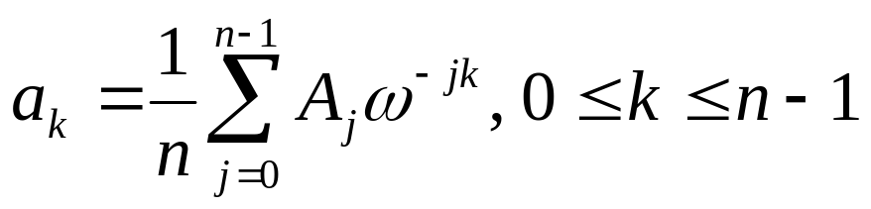
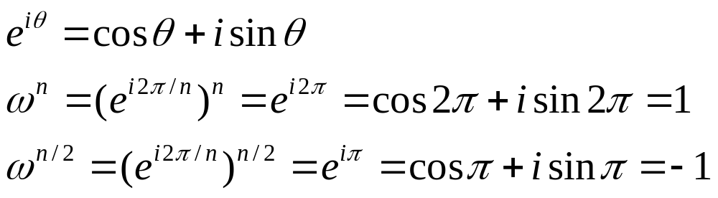
FFT Algorithm
Inverse DFT:
DFT can be computed in O(n²) time by a straightforward method.
DFT can be solved by the divide-and-conquer strategy (FFT) in O(nlogn) time.

Slide 42
FFT Algorithm when n=4
n=4, w=e^{i2π/4} , w⁴=1, w²=-1
  A₀=a₀+a₁+a₂+a₃
  A₁=a₀+a₁w+a₂w²+a₃w³
  A₂=a₀+a₁w²+a₂w⁴+a₃w⁶
  A₃=a₀+a₁w³+a₂w⁶+a₃w⁹
Another form:
  A₀ =(a₀+a₂)+(a₁+a₃)
  A₂ =(a₀+a₂w⁴)+(a₁w²+a₃w⁶) =(a₀+a₂)-(a₁+a₃)
When we calculate A₀, we shall calculate (a₀+a₂) and (a₁+a₃). Later, A₂ can be easily calculated.
Similarly,
  A₁ =(a₀+ a₂w²)+(a₁w+a₃w³) =(a₀-a₂)+w(a₁-a₃)
  A₃ =(a₀+a₂w⁶)+(a₁w³+a₃w⁹) =(a₀-a₂)-w(a₁-a₃).

Slide 43
FFT algorithm when n = 8
n=8, w=e^{i2π/8}, w⁸=1, w⁴=-1
A₀=a₀+a₁+a₂+a₃+a₄+a₅+a₆+a₇
A₁=a₀+a₁w+a₂w²+a₃w³+a₄w⁴+a₅w⁵+a₆w⁶+a₇w⁷
A₂=a₀+a₁w²+a₂w⁴+a₃w⁶+a₄w⁸+a₅w¹⁰+a₆w¹²+a₇w¹⁴
A₃=a₀+a₁w³+a₂w⁶+a₃w⁹+a₄w¹²+a₅w¹⁵+a₆w¹⁸+a₇w²¹
A₄=a₀+a₁w⁴+a₂w⁸+a₃w¹²+a₄w¹⁶+a₅w²⁰+a₆w²⁴+a₇w²⁸
A₅=a₀+a₁w⁵+a₂w¹⁰+a₃w¹⁵+a₄w²⁰+a₅w²⁵+a₆w³⁰+a₇w³⁵
A₆=a₀+a₁w⁶+a₂w¹²+a₃w¹⁸+a₄w²⁴+a₅w³⁰+a₆w³⁶+a₇w⁴²
A₇=a₀+a₁w⁷+a₂w¹⁴+a₃w²¹+a₄w²⁸+a₅w³⁵+a₆w⁴²+a₇w⁴⁹

Slide 44
After reordering, we have
A₀=(a₀+a₂+a₄+a₆)+(a₁+a₃+a₅+a₇)
A₁=(a₀+a₂w²+a₄w⁴+a₆w⁶)+ w(a₁+a₃w²+a₅w⁴+a₇w⁶)
A₂=(a₀+a₂w⁴+a₄w⁸+a₆w¹²)+ w²(a₁+a₃w⁴+a₅w⁸+a₇w¹²)
A₃=(a₀+a₂w⁶+a₄w¹²+a₆w¹⁸)+ w³(a₁+a₃w⁶+a₅w¹²+a₇w¹⁸)
A₄=(a₀+a₂+a₄+a₆)-(a₁+a₃+a₅+a₇)
A₅=(a₀+a₂w²+a₄w⁴+a₆w⁶)-w(a₁+a₃w²+a₅w⁴+a₇w⁶)
A₆=(a₀+a₂w⁴+a₄w⁸+a₆w¹²)-w²(a₁+a₃w⁴+a₅w⁸+a₇w¹²)
A₇=(a₀+a₂w⁶+a₄w¹²+a₆w¹⁸)-w³(a₁+a₃w⁶+a₅w¹²+a₇w¹⁸)
Rewrite as
A₀=B₀+C₀ A₄=B₀-C₀=B₀+w⁴C₀
A₁=B₁+wC₁ A₅=B₁-wC₁=B₁+w⁵C₁
A₂=B₂+w²C₂ A₆=B₂-w²C₂=B₂+w⁶C₂
A₃=B₃+w³C₃ A₇=B₃-w³C₃=B₃+w⁷C₃

Slide 45
B₀=a₀+a₂+a₄+a₆
B₁=a₀+a₂w²+a₄w⁴+a₆w⁶
B₂=a₀+a₂w⁴+a₄w⁸+a₆w¹²
B₃=a₀+a₂w⁶+a₄w¹²+a₆w¹⁸
Let x=w²=e^{i2π/4}
B₀=a₀+a₂+a₄+a₆
B₁=a₀+a₂x+a₄x²+a₆x³
B₂=a₀+a₂x²+a₄x⁴+a₆x⁶
B₃=a₀+a₂x³+a₄x⁶+a₆x⁹
Thus, {B₀,B₁,B₂,B₃} is FFT of {a₀,a₂,a₄,a₆}.
Similarly, {C₀,C₁,C₂,C₃} is FFT of {a₁,a₃,a₅,a₇}.

Slide 46
General FFT
In general, let w=e^{i2π/n} (assume n is even.)
w^{n}=1, w^{n/2}=-1
  A_{j} =a₀+a₁w^{j}+a₂w^{2j}+…+a_{n-1}w^{(n-1)j},
  ={a₀+a₂w^{2j}+a₄w^{4j}+…+a_{n-2}w^{(n-2)j}}+
  w^{j}{a₁+a₃w^{2j}+a₅w^{4j}+…+a_{n-1}w^{(n-2)j}}
  =B_{j}+w^{j}C_{j}
  A_{j+n/2}=a₀+a₁w^{j+n/2}+a₂w^{2j+n}+a₃w^{3j+3n/2}+…
  +a_{n-1}w^{(n-1)j+n(n-1)/2}
  =a₀-a₁w^{j}+a₂w^{2j}-a₃w^{3j}+…+a_{n-2}w^{(n-2)j}-a_{n-1}w^{(n-1)j}
  =B_{j}-w^{j}C_{j}
  =B_{j}+w^{j+n/2}C_{j}

Slide 47
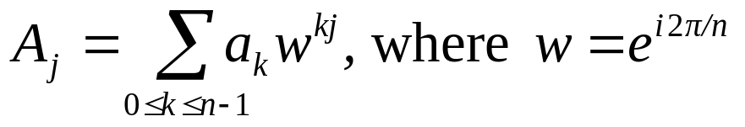
Divide-and-Conquer (FFT)
Input: a₀, a₁, …, a_{n-1}, n = 2^{k}
Output: A_{j}, j=0, 1, 2, …, n-1
where
Step 1: If n = 2, compute
A₀ = a₀ + a₁,
A₁ = a₀ - a₁, and return.
Step 2: Recursively find the Fourier transform of {a₀, a₂, a₄,…, a_{n-2}} and {a₁, a₃, a₅,…,a_{n-1}}, whose results are denoted as {B₀, B₁, B₂,…, B_{n/2-1}} and {C₀, C₁, C₂,…, C_{n/2-1}}.

Slide 48
Step 3: Compute A_{j}:
A_{j} = B_{j} + w^{j}C_{j} for 0 ≤ j ≤ n/2 - 1
A_{j+n/2} = B_{j} - w^{j}C_{j} for 0 ≤ j ≤ n/2 - 1.
Time complexity:
T(n) = 2T(n/2) + O(n)
= O(n log n)

